Slide 1

Probabilistic Route Selection for On-Time Arrival under Traffic Uncertainty
CSE 400: Fundamentals of Probability in Computing
Intelligent Transport Systems
Urban traffic causes unpredictable travel times
Travel times behaves as a random variable
On-time arrival matters more than average time

Slide 2
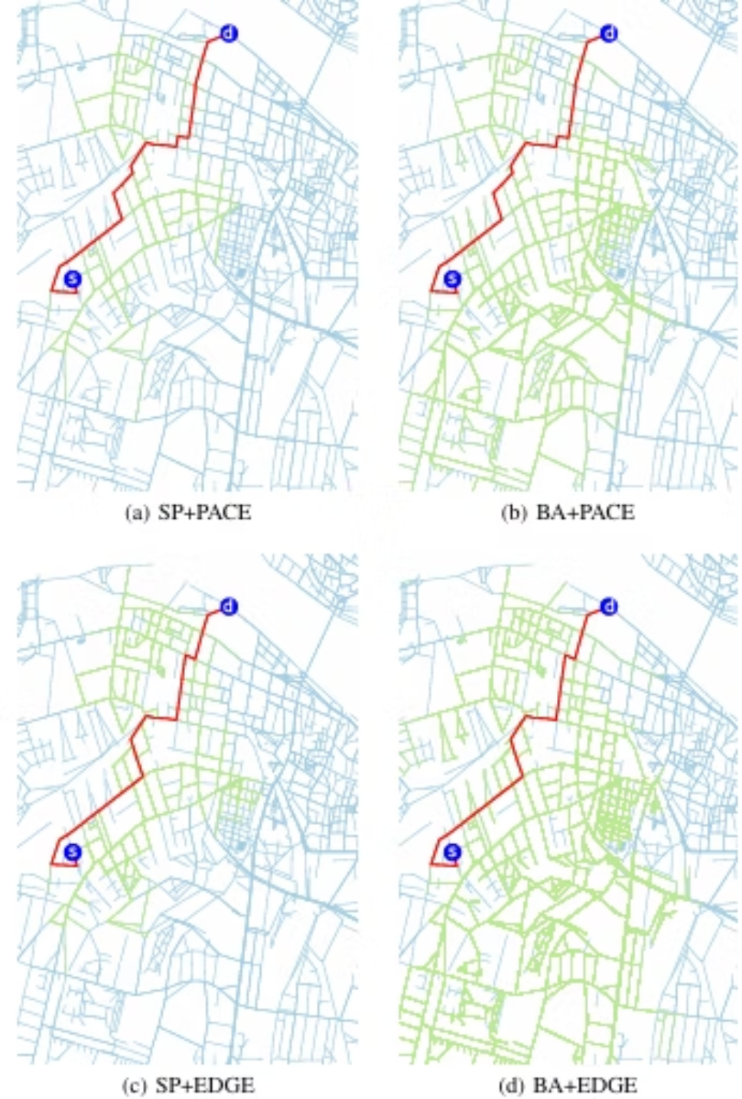
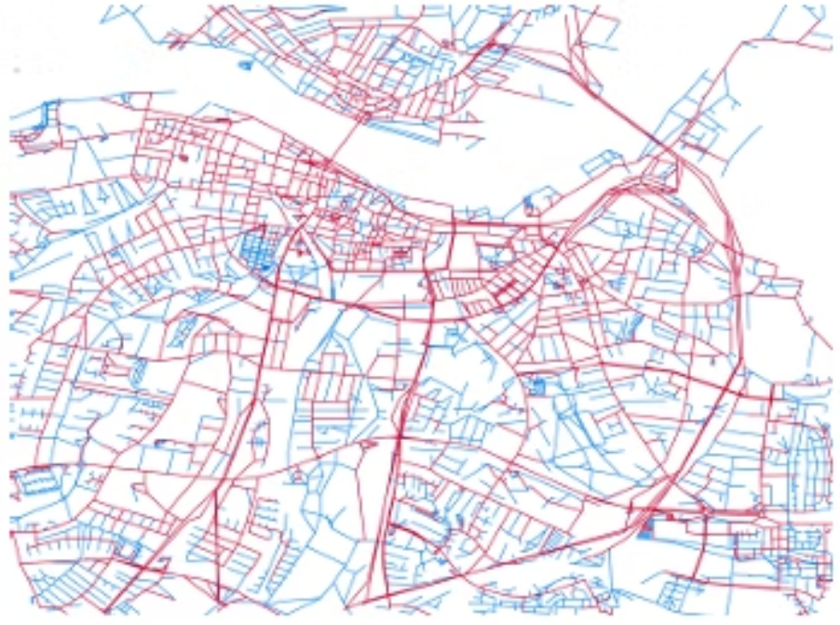
Project Objective and Scope
Objective
Our primary objective is to maximize the probability of arriving before a given deadline. This goes beyond simply finding the shortest path; it's about finding the most reliable path.
- What is being Estimated?
Travel time distributions of routes
- What is being Decided?
Selection of the route with the highest on-time arrival probability.

Slide 3






Project System Overview
Real-Time Traffic Data
Live congestion indicators
Sensor feeds
Historical Congestion Data
Past traffic patterns
Delay statistics
Probabilistic Travel-Time Model
Uncertainty modeling
Travel time as random variable
On-Time Arrival Probability Computation
Probability of reaching destination within deadline
Optimal Route Selection
Route with highest on-time probability

Slide 4



Sources of Uncertainty
Traffic Congestion Variability
Random Delays
Data Uncertainty & Model Approximation
Traffic Signals
Weather and minor incidents
Fluctuating traffic delay
Accident and Roadworks
Noisy or incomplete data
Simplifying modelling assumptions.

Slide 5
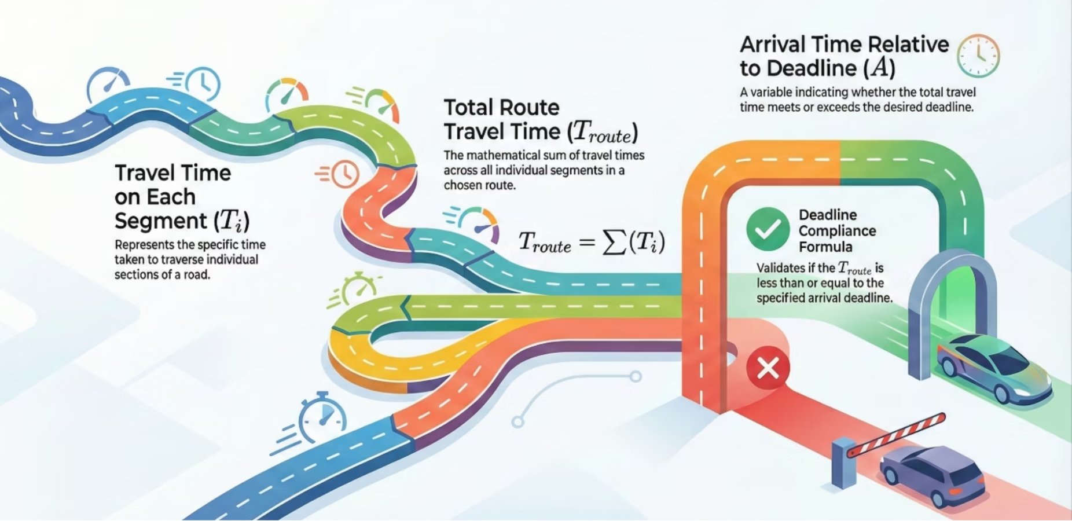
Key Random Variables and Their Roles
1
Travel Time on Each Segment (T_i)
Represents the time taken to traverse individual road sections.
2
Total Route Travel Time (T_route)
The sum of travel times across all segments in a chosen route.
3
Arrival Time Relative to Deadline (A)
Indicates whether the total travel time is less than or equal to the desired deadline.

Slide 6
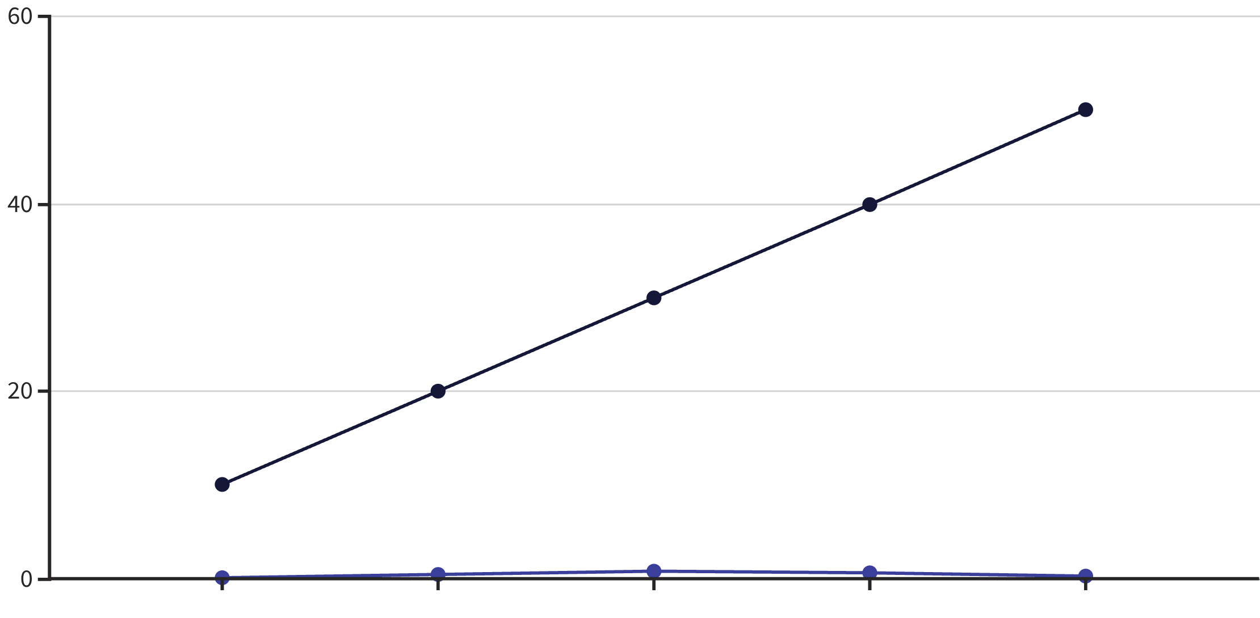
Probabilistic Models and Assumptions
Probability Distributions
Travel times on road segments are modeled using appropriate probability distributions (e.g., Lognormal, Gamma, or empirical distributions).
These distributions capture the inherent variability and skewness often observed in real-world traffic data.
Assumptions
Initial assumption of independence between segment travel times for simplicity.
Conditional dependence can be introduced for segments influenced by shared traffic events.
Time
Probability Density
An example of a probability distribution curve for travel time.

Slide 7




Probabilistic Reasoning and Inference Logic
Model Segment Times
Assign probability distributions to individual road segment travel times based on historical data.
Combine Segment Distributions
For each route, combine the distributions of its segments to obtain the total travel time distribution.
Compute On-Time Probability
Calculate the area under the total travel time distribution curve up to the specified deadline.
Select Optimal Route
Choose the route with the highest computed probability of arriving on time.

Slide 8
Operationalizing Probabilistic Reasoning
Simulations and Experiments
Evaluation Metric
We use Monte Carlo simulations to sample travel times from our defined distributions and evaluate route performance under various scenarios.
Probability of On-Time Arrival (P(T_route ≤ Deadline)) is the key metric.
Simplifying Assumptions
This allows us to test the robustness of our route selection algorithm.
Initial focus on a static network topology.
Assumption of available and accurate historical traffic data.

Slide 9

Current Limitations and Conceptual Gaps
Correlation vs. Independence: The assumption of independence between segment travel times may not hold in dense networks, where congestion propagates.
Dynamic Traffic Modeling: Our current model might not fully capture rapidly changing traffic conditions and sudden, unpredictable events.
Data Granularity: Lack of fine-grained historical data can lead to less precise probability distributions.
User Preferences: Model currently prioritizes on-time arrival, not considering user preferences like scenic routes or fuel efficiency.

Slide 10




Planned Refinements and Role Coordination
Enhanced Correlation Modeling
Machine Learning Integration
Introduce models that account for spatial and temporal correlations between road segments.
Utilize ML models for more accurate real-time traffic prediction and distribution parameter estimation.
Better Data Utilization
Role of Reviewer / GitHub Manager
Explore richer datasets and advanced data fusion techniques for improved model accuracy.
Crucial for coordinating code merges, ensuring consistency, and providing technical feedback on model improvements.

Slide 11

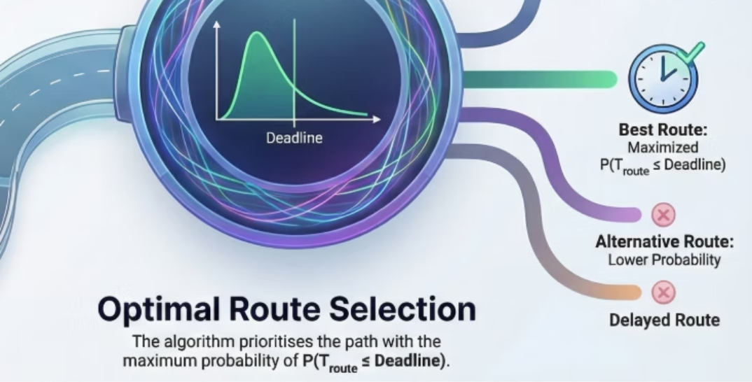

Summary of Group-Level Understanding
Paradigm Shift
Modeling & Inference
Uncertainty & Limitations
Our project moves from a deterministic view of travel time to a stochastic one, where travel time is treated as a random variable. Instead of minimizing average travel time, the objective is to select the most reliable route by maximizing the probability of arriving before a given deadline.
Individual road segments are modeled using probability distributions rather than fixed averages. These uncertainties are aggregated at the route level to compute the probability that the total travel time meets the deadline. Monte Carlo simulations are used to validate this probabilistic reasoning under random traffic conditions.
While the model accounts for congestion variability, signal delays, and imperfect data, it currently assumes independence between road segments. Future work will focus on incorporating correlation modeling and machine learning to better capture real-world traffic dependencies.

